Slide 1
CCE DATA SCIENCE & MACHINE LEARNING
MARCH 26TH, 2021
INTERNS: Justin Chow & Katherine Tatley
MANAGER: Kun Zan

Slide 2
INTRODUCTION
01
IN DEPTH
02
NUMERICAL VARIABLE
IN BRIEF
TABLE OF CONTENTS
04
03
CATEGORICAL VARIABLE
05
POTENTIAL RELATIONSHIP
06
INTRODUCE HOUSE PRICE DATASET
MISSING VARIABLES & OUTLIERS
DEFINITION AND DISTRIBUTION (EITHER MONOTONIC OR NON-MONOTONIC)
PURPOSE/OBJECTIVE BEHIND DATA ANALYSIS
DEFINITION AND CARDINALITY EVALUATE HOW MANY CATEGORIES ARE PRESENT.
RARE LABELS - EXPLORE RELATIONSHIP BETWEEN VARIABLES AND HOUSE PRICE

Slide 3
01
INTRODUCTION

Slide 4
OUR NUMBERS
1460
81
3
Rows i.e., number of houses
Columns i.e., variables
Comma-separated value files
Notes:
House Prices - Advanced Regression Techniques | Kaggle

Slide 5
FILE DESCRIPTION
train.csv - the training set
test.csv - the test set
data_description.txt - full description of each column, originally prepared by Dean De Cock but lightly edited to match the column names used here.
sample_submission.csv - a benchmark submission from a linear regression on year and month of sale, lot square footage, and number of bedrooms.

Slide 6
DATA FIELDS
ORDINAL
Mixture of categorical and numerical data
DATA FIELDS
Location for a predetermined type of data that - collectively with other fields - describes the place it is stored.
Saturn is a gas giant, composed of hydrogen and helium
CATEGORICAL
NUMERICAL
Characteristics that can take on numerical or qualitative data
Measurements broken into two types of data: discrete & continuous
Notes:
Types of Statistical Data: Numerical, Categorical, and Ordinal - dummies

Slide 7
02
IN DEPTH

Slide 8

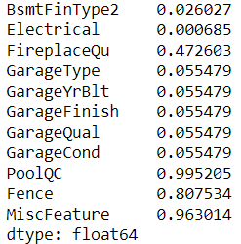
IN DEPTH
MISSING VALUES
For numeric data, pandas uses the floating-point value NaN (Not a Number) to represent missing data or sentinel value that can easily be detected.
Categories with greater than 80% of their non-num values
Alley (type of alley access),
Pool QC (pool quality),
Fence (fence quality), and
Misc_Feature (Miscellaneous features not covered in other categories)

Slide 9
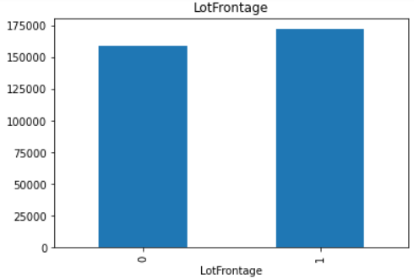
IN DEPTH
RELATIONSHIP
Compare the median sales price in the observations where data is missing versus when data is available.
The average Sale Price in houses where the information is missing, differs from the average Sale Price in houses where information exists.
In this instance, the linear feet of street connected to property had little change in prices.
Comparing Lot Frontage (Linear feet of street connected to property) to median sales price.

Slide 10
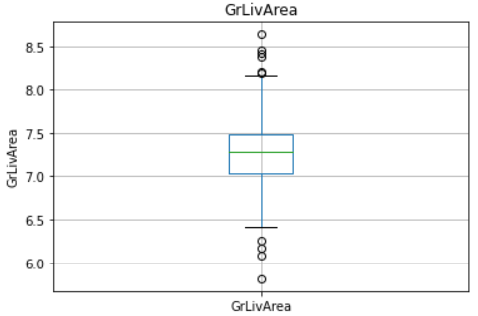
IN DEPTH
OUTLIERS
Extreme values may affect the performance of the linear model.
The majority of the continuous variables seem to contain outliers.
In this instance, the grade/ground living area in square feet has the furthest outliers, which suggests a wide variety of living space.
Gr_Liv_Area (above grade/ground living area in square feet) serves as a continuous variable with the furthest outliers.

Slide 11
03
IN BRIEF

Slide 12
OBJECTIVES
DATASET
IMPORTANCE
PREDICT
RESULT
THOUGHTS
FEATURES
Find a reliable dataset that contains house sale prices in the US market as well as the explanatory variables.
Predicting house prices is useful to identify fruitful investments, or to determine whether the price advertised for a house is over or under-estimated.
Build a machine learning model to predict the sale price of homes based on different explanatory variables describing aspects of residential houses.
Minimise the difference between the real price and the price estimated by our model.
There is certainly more to be done to understand the nature of this data and the relationship of these variables with the target, Sale Price.
Through data exploration, we decide which feature engineering techniques we will apply to our variables.

Slide 13
04
NUMERICAL VARIABLE

Slide 14

NUMERICAL
Numerical data further broken into two types: discrete and continuous.

Slide 15
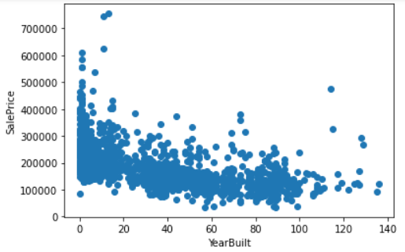

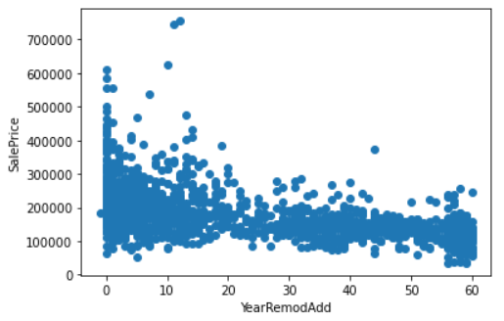

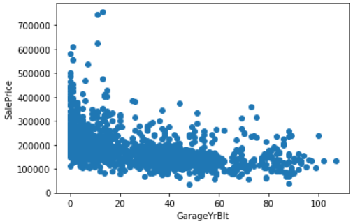

TEMPORAL VARIABLES
YEAR BUILT
YEAR REMODEL ADD
GARAGE YR BLT
year in which the house was built
year in which the house was remodeled
year in which a garage was built

Slide 16
OBSERVATIONS
JUSTIN CHOW
KATHERINE TATLEY
“The longer the time between the house was built or remodeled and sale date, the lower the sale price.”
“The elapsed years between the Year variables and the year in which the house was sold has a monotonic relationship.”

Slide 17
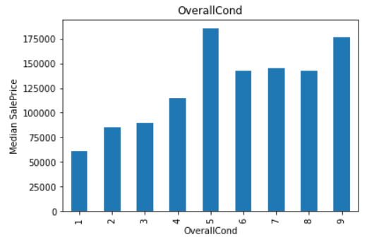
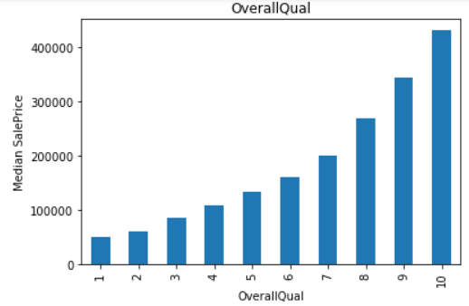
DISCRETE VARIABLES
MONOTONIC
NON-MONOTONIC
Notes:
There tend to be a relationship between the variables values and the Sale Price, but this relationship is not always monotonic. For example, for Overall Qual, there is a monotonic relationship: the higher the quality, the higher the Sale Price. However, for Overall Cond, the relationship is not monotonic. Clearly, some Condition grades, like 5, correlate with higher sale prices, but higher values do not necessarily do so. We need to be careful on how we engineer these variables to extract maximum value for a linear model.

Slide 18
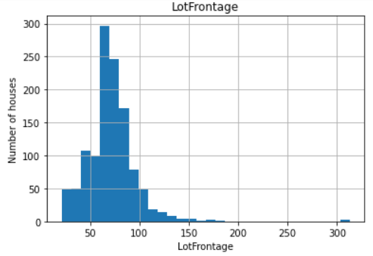
ANALYZE DISTRIBUTION
RESULT
The variables are not normally distributed, including the target variable 'Sale Price'.
In this instance, the linear feet of street to number of horses remains normally distributed.
To maximise performance of linear models, we need to account for non-Gaussian distributions. We will transform our variables in the next lecture / video, during our feature engineering step.
Comparing Lot Frontage (Linear feet of street connected to property) to number of houses.

Slide 19
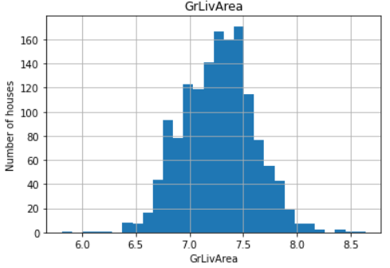
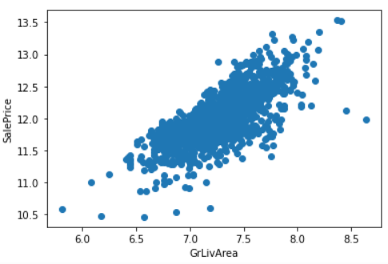
CONTINUOUS VARIABLES
LOGARITHMIC TRANSFORMATION
Notes:
We get a better spread of the values for most variables when we use the logarithmic transformation. This engineering step will most likely add performance value to our final model. From the previous plots, we observe some monotonic associations between SalePrice and the variables to which we applied the log transformation, for example ground living area in square feet.

Slide 20
05
CATEGORICAL VARIABLES

Slide 21
NUMBER OF LABELS: CARDINALITY
MSZONING, LOT CONFIG, BLDG_TYPE,
ROOF_STYLE, ETC.
EXTERIOR 1ST
EXTERIOR 2ND
15/16
5/6
25
8/9
2/3
NEIGHBORHOOD
CONDITION 1/2, HOUSE_STYLE, ROOF_MATL, SALE_TYPE
STREET, ALLEY, UTILITIES, LAND SLOPE, GARAGE_FINISH
Notes:
All the categorical variables show low cardinality, this means that they have only few different labels.

Slide 22
06
POTENTIAL RELATIONSHIP

Slide 23
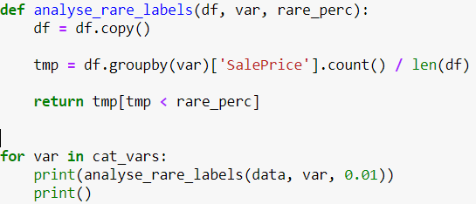
ANALYZE RARE LABELS
TMP
determine the % of observations per category
RETURN
return categories that are rare
PRINT
print categories that are present in less than
1 % of the observations
Notes:
Some of the categorical variables show multiple labels that are present in less than 1% of the houses. We will engineer these variables in our next video. Labels that are under-represented in the dataset tend to cause overfitting of machine learning models. That is why we want to remove them.

Slide 24
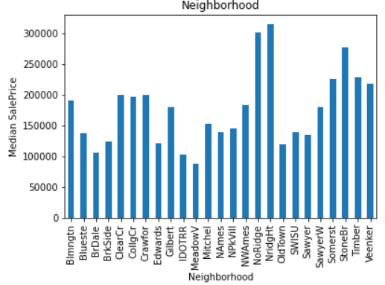
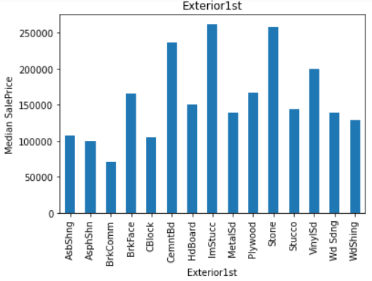
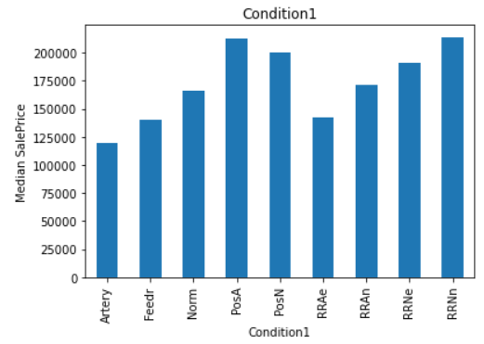
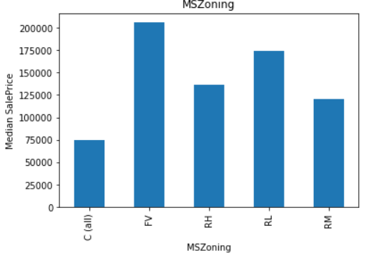
RARE VARIABLES
NEIGHBORHOOD
EXTERIOR 1
CONDITION 1
MS_ZONING
Physical location within Ames city limits
Exterior covering on the house (more than one)
Proximity to main road or railroad (if a second is present)
General zoning classification
Notes:
Clearly, the categories give information on the Sale Price, as different categories show different median sale prices.

Slide 25
THANKS
Does anyone have any questions?
Jchow2@scu.com
katherine.tately@gmail.com
kzan27@gmail.com
I Fly Young CCE

